Slide 1
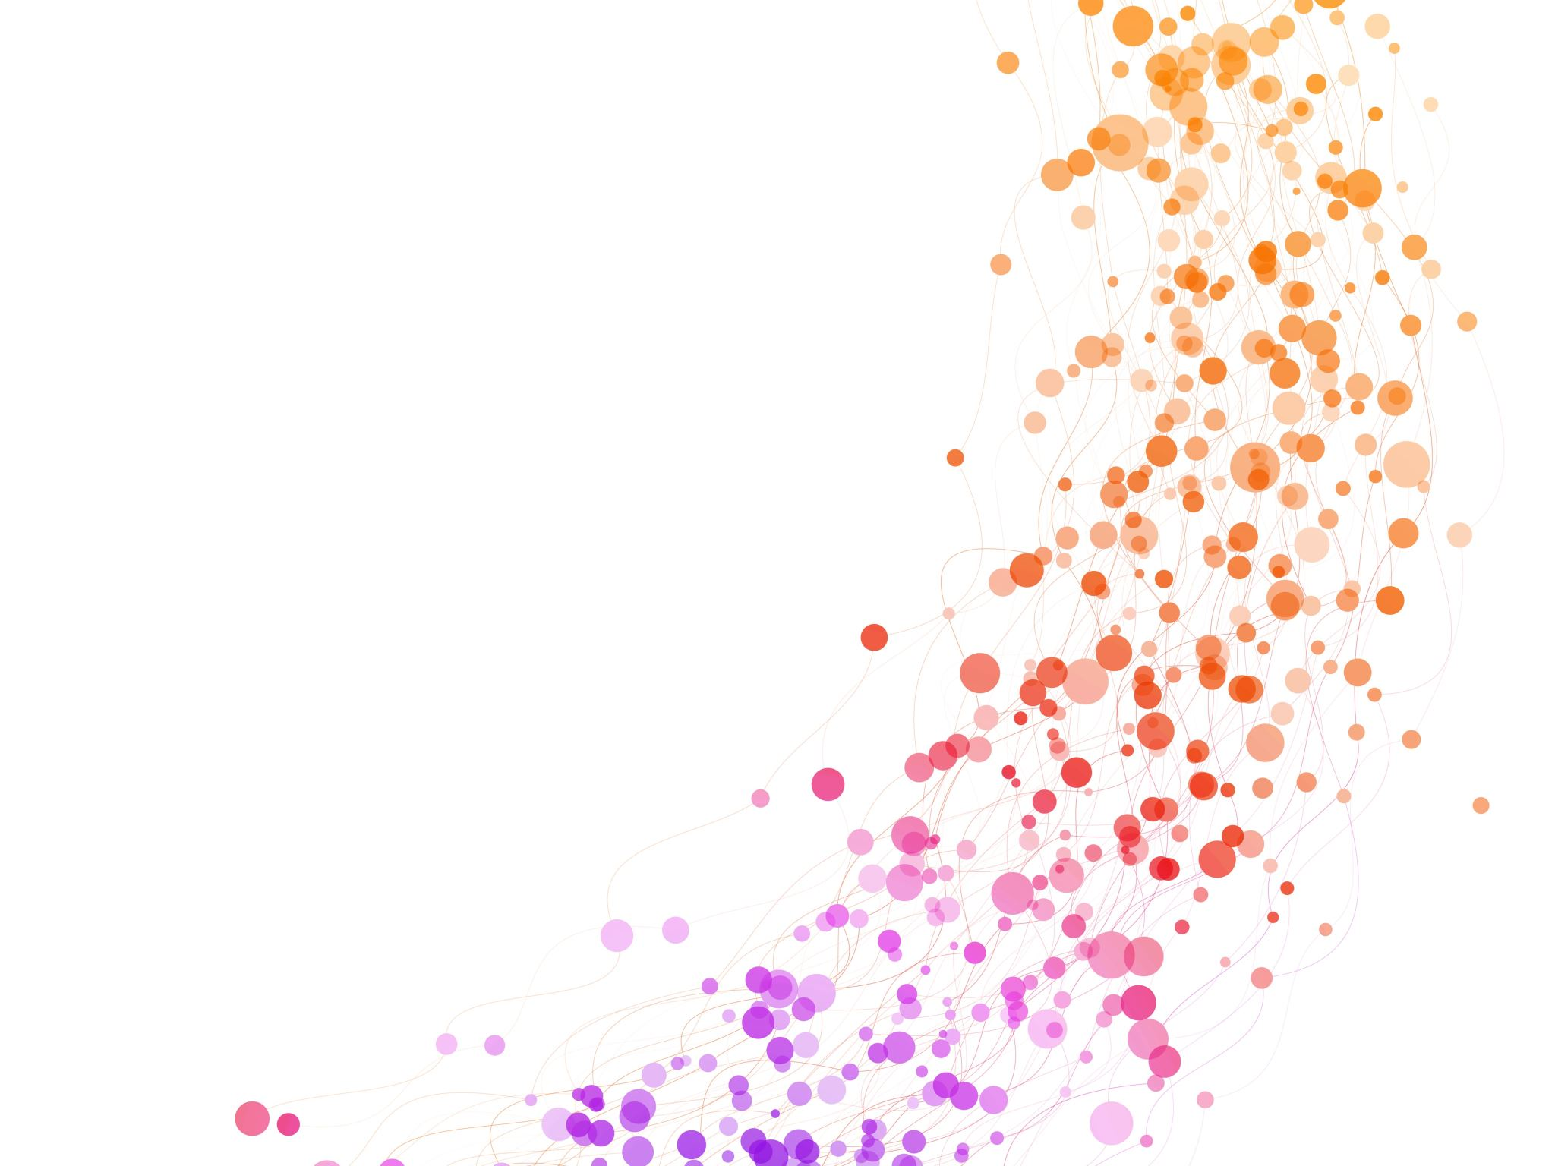
OBESITY PREDICTION
BY EVA BEYEBACH
MS-4203

Slide 2
Background
In 2022, 1 in 8 people in the world were living with obesity and 2.5 billion adults had overweight.
Can lead to increased risk of type 2 diabetes, diseases and influence sleeping quality.
The diagnosis of overweight and obesity is made by calculating the body mass index (BMI): weight (kg)/height² (m²).
Research suggests “severe OSA led to a 65% greater risk of developing any kind of cancer.”
Having good sleep quality and enough sleep hours is also a good mitigator of cancer.
Researchers found an increased risk of heart disease and total cancer, in patients with a higher resting heart rate.

Slide 3
Motivation
Our objective is to enhance the overall health of patients.
We want to analyze which factors have influence over sleep quality, to improve the patients sleep and reduce cancer risks.
We also aim to examine the factors contributing to high blood pressure and heart rate in order to facilitate lifestyle improvements and reduce cancer risks.
Our aim is to provide patients with recommendations to lower their BMI to foster a healthier lifestyle.

Slide 4
Problem
Which variables are significant predictors of BMI and which variables could reduce obesity?
Do obese people have sleep disorders and poor sleep quality? If yes, how can we improve that?
Which variables influence high blood pressure or high heart rate?
Which model is the best model to predict BMI Category?
Which other variables correlate with each other? How can we further improve patient lifestyle overall?

Slide 5
Data
Sleep Health and Lifestyle Dataset from Kaggle
374 observations and 13 variables
Physical Activity Level (minutes/day): The number of minutes the person engages in physical activity daily. Stress Level (scale: 1-10): A subjective rating of the stress level experienced by the person, ranging from 1 to 10. BMI Category: The BMI category of the person (e.g., Underweight, Normal, Overweight). Blood Pressure (systolic/diastolic): The blood pressure measurement of the person, indicated as systolic pressure over diastolic pressure. Heart Rate (bpm): The resting heart rate of the person in beats per minute.
Daily Steps: The number of steps the person takes per day. Sleep Disorder: The presence or absence of a sleep disorder in the person (None, Insomnia, Sleep Apnea).
Person ID: An identifier for each individual. Gender: The gender of the person (Male/Female). Age: The age of the person in years. Occupation: The occupation or profession of the person. Sleep Duration (hours): The number of hours the person sleeps per day. Quality of Sleep (scale: 1-10): A subjective rating of the quality of sleep, ranging from 1 to 10.

Slide 6
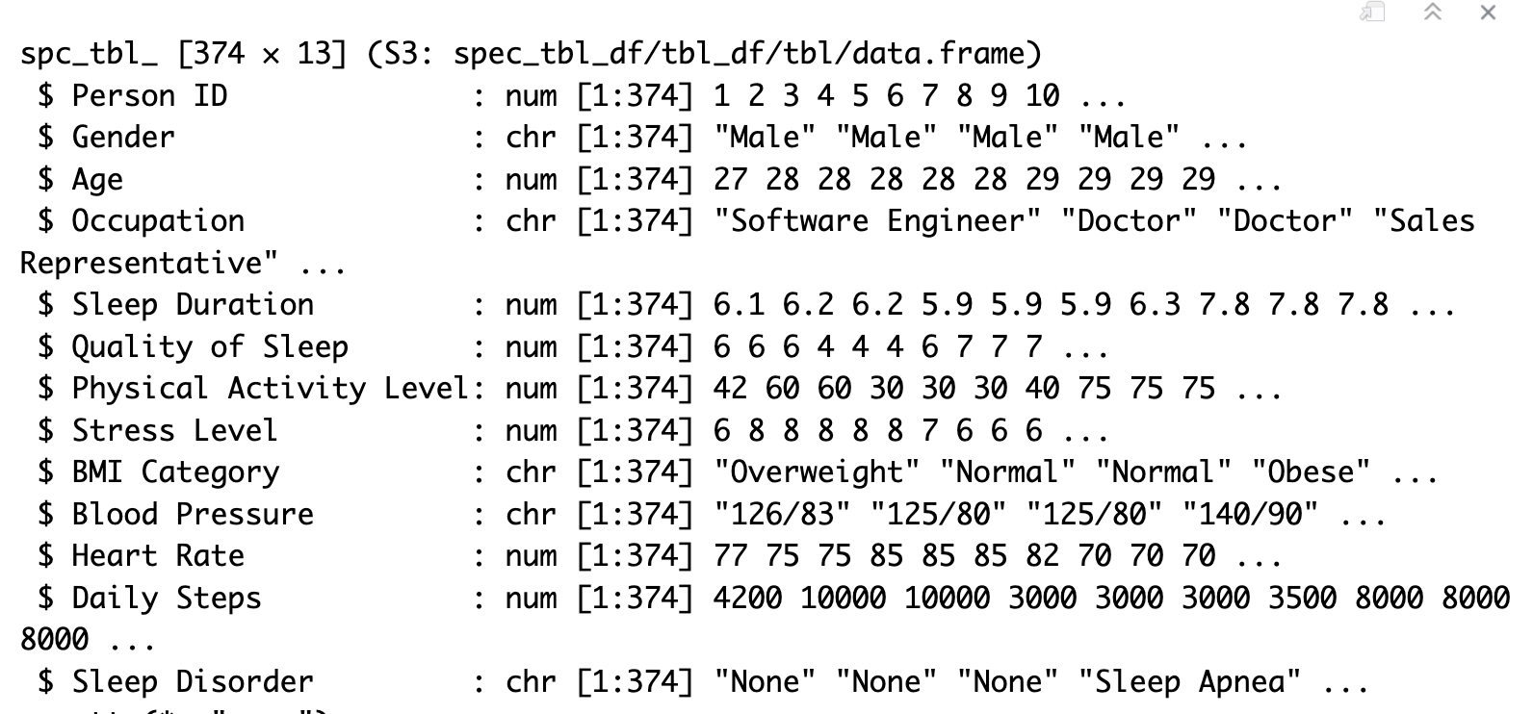
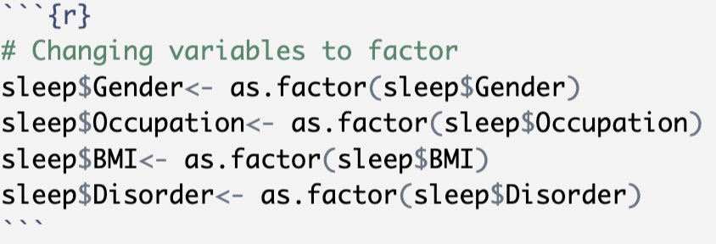
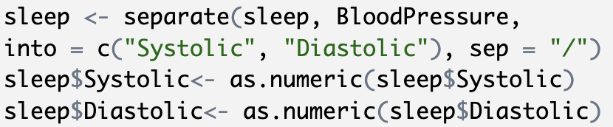
Data Preparation: Structure

Slide 7
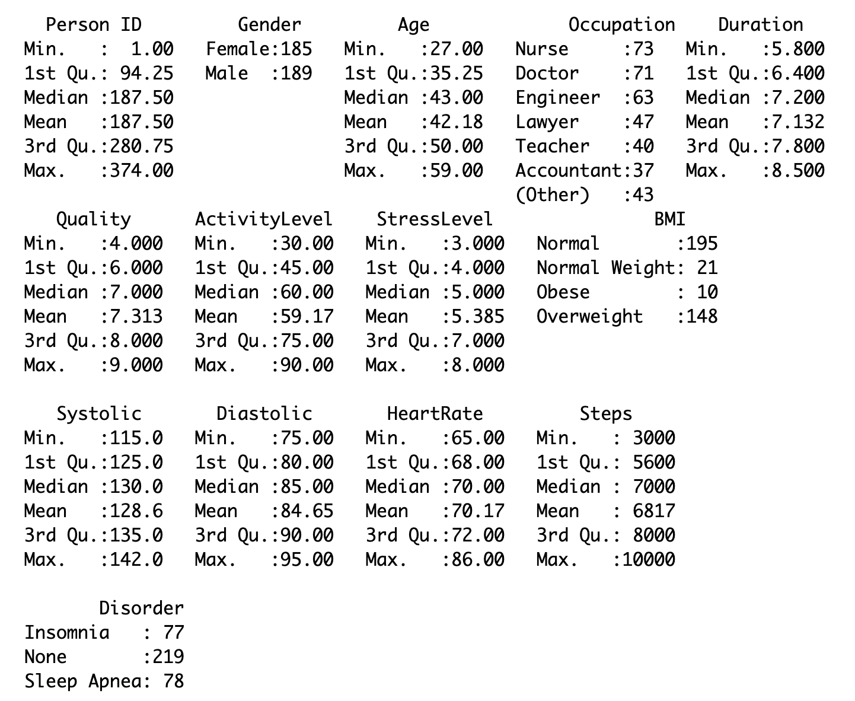
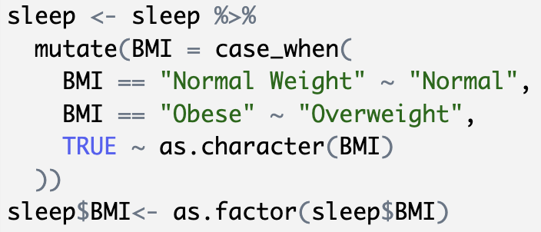
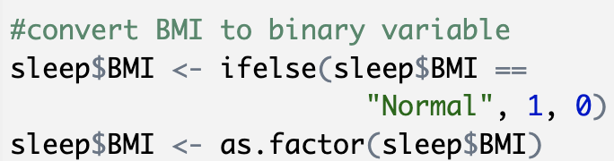
Data Preparation:
Summary
No missing values
No duplicates

Slide 8
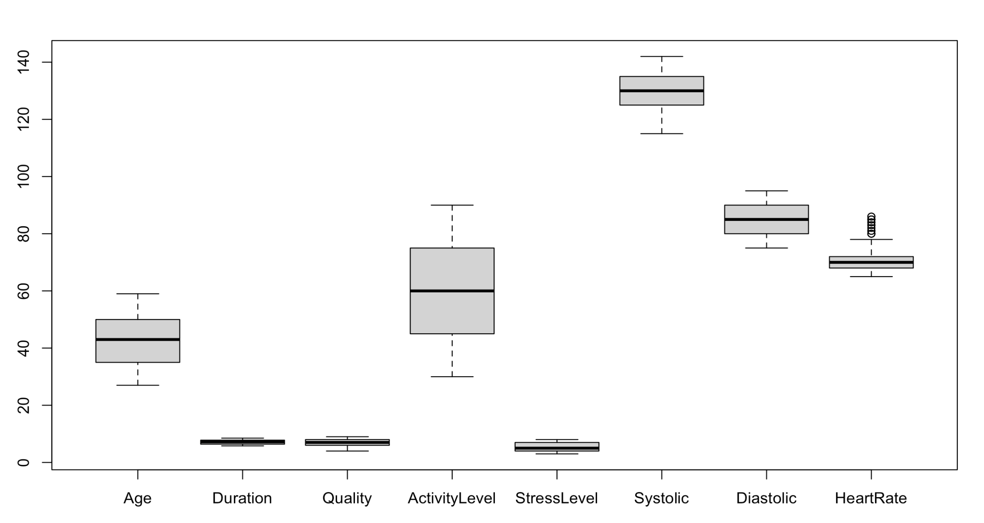
Data Preparation: Outliers
HeartRate has some outliers
We will not remove them, because
they are important for the analysis

Slide 9
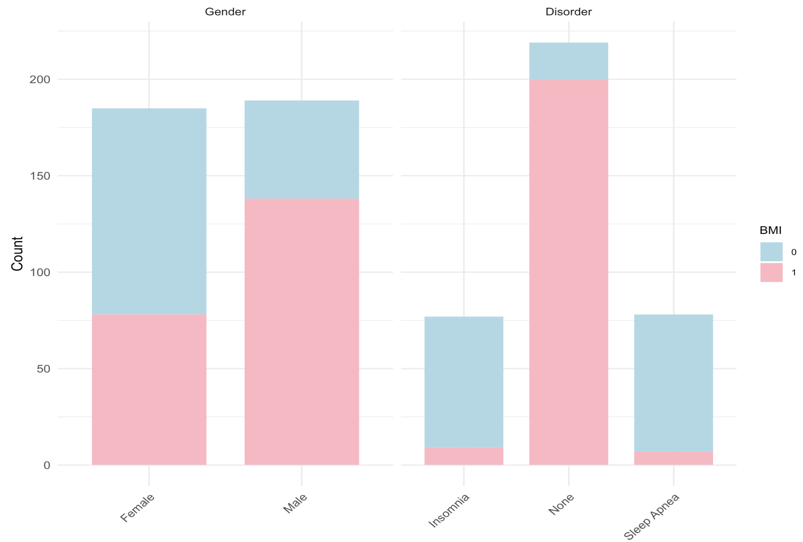
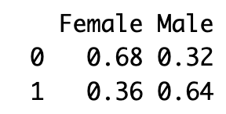
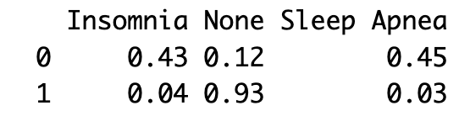
Data Visualization by BMI: Categorical Variables
68% of females and 32% of males
have overweight
88% of people with overweight
have Sleep Disorders

Slide 10
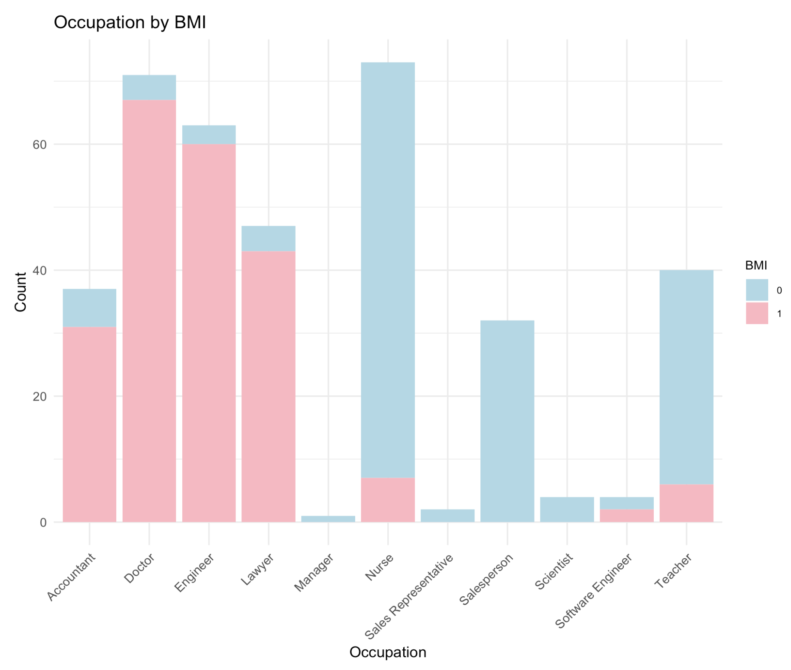
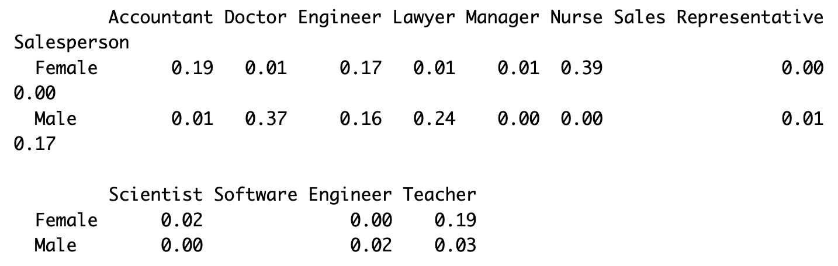
Data Visualization by BMI: Categorical Variables
Most of the Occupations, were people had overweight, have more women than men and vice versa
0= Overweight
1= Normal

Slide 11
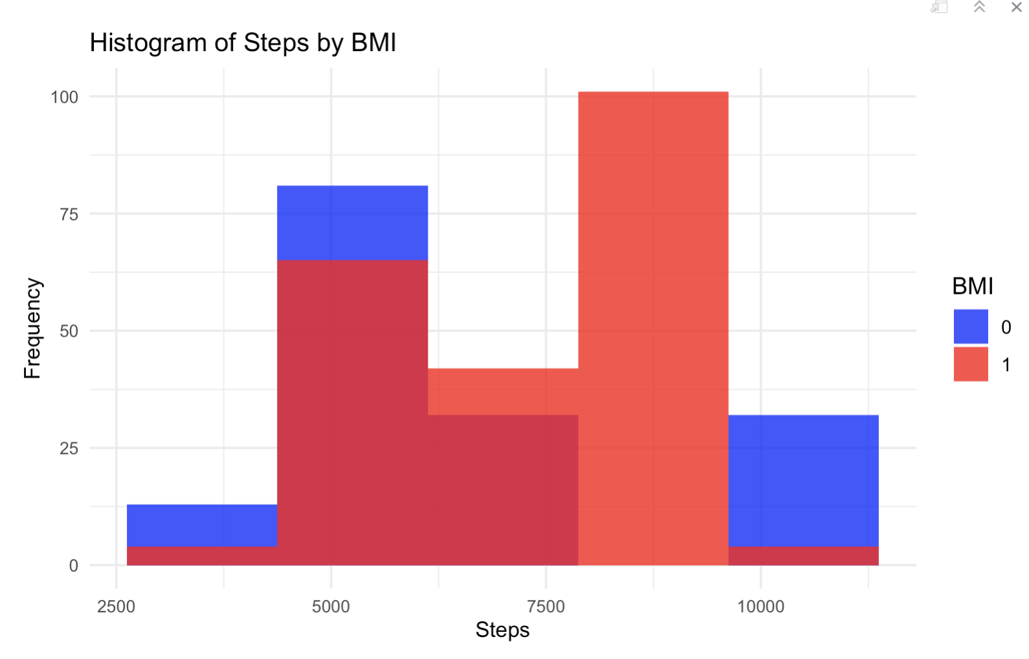
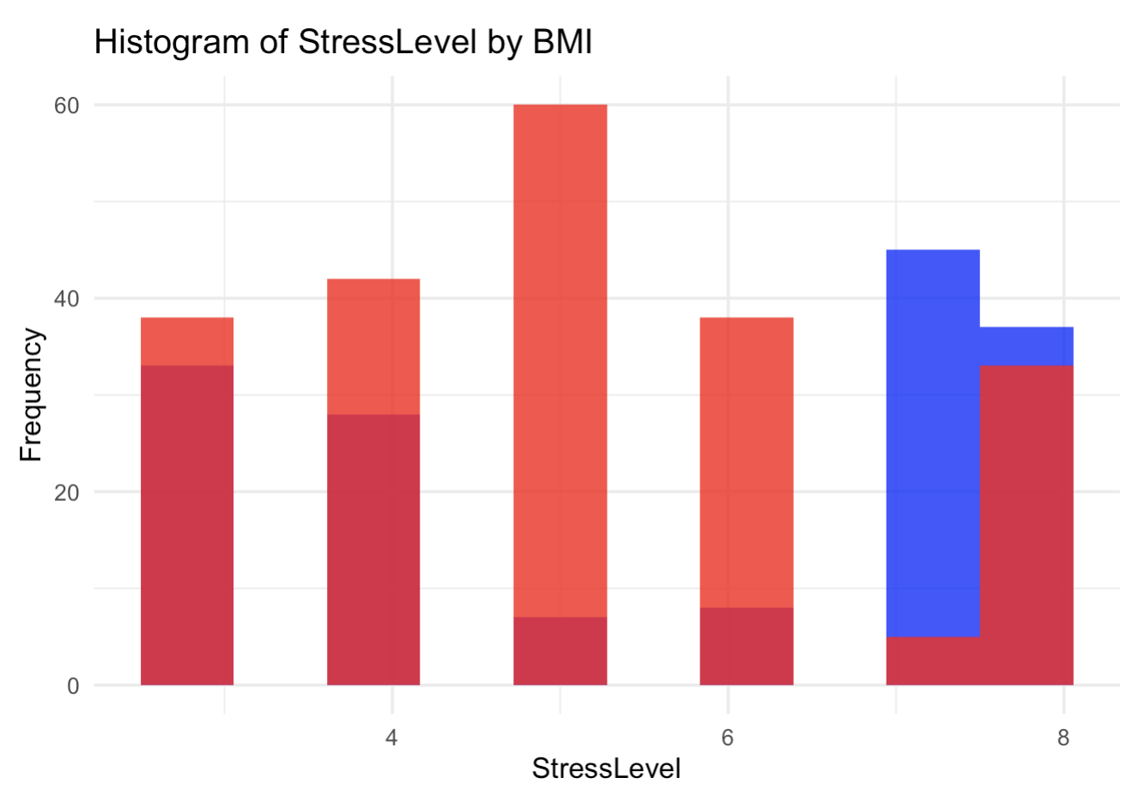
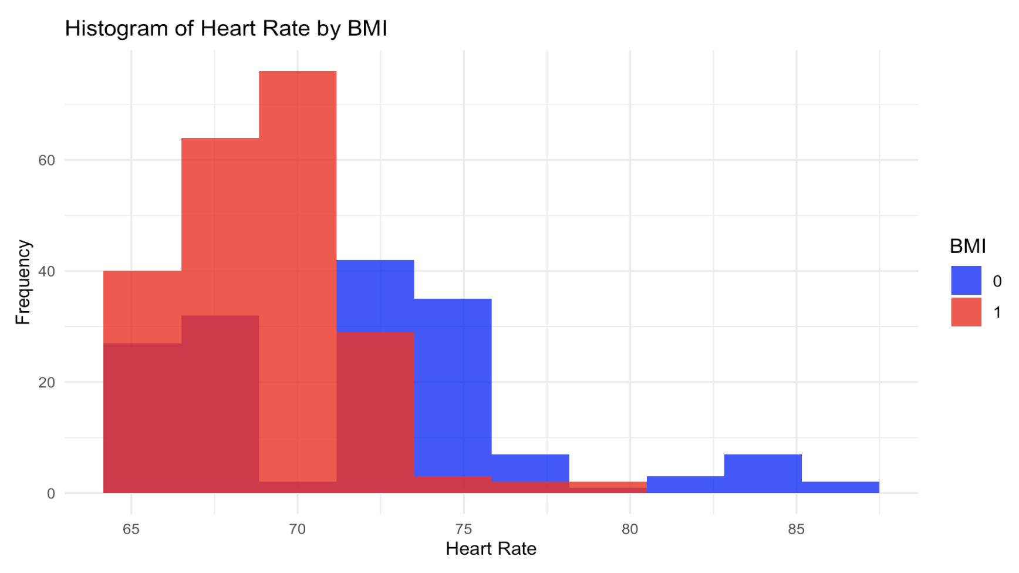
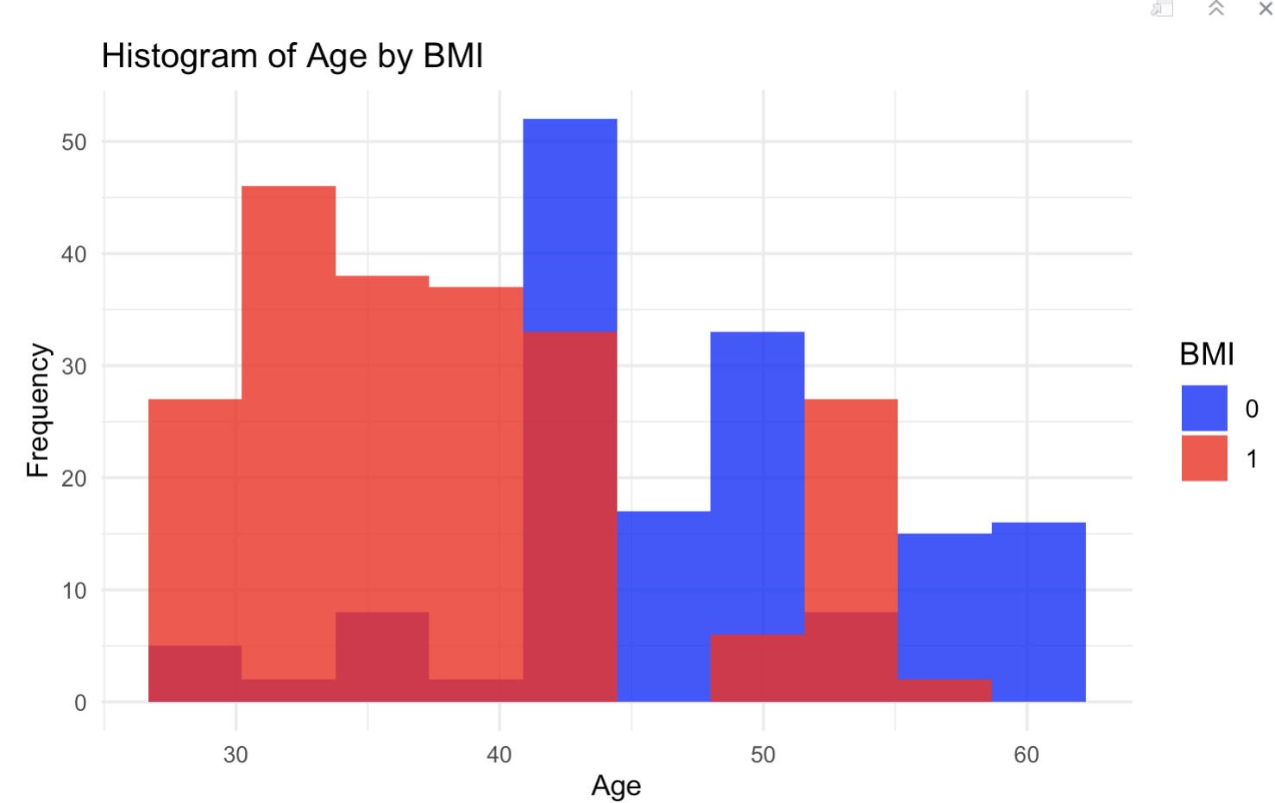
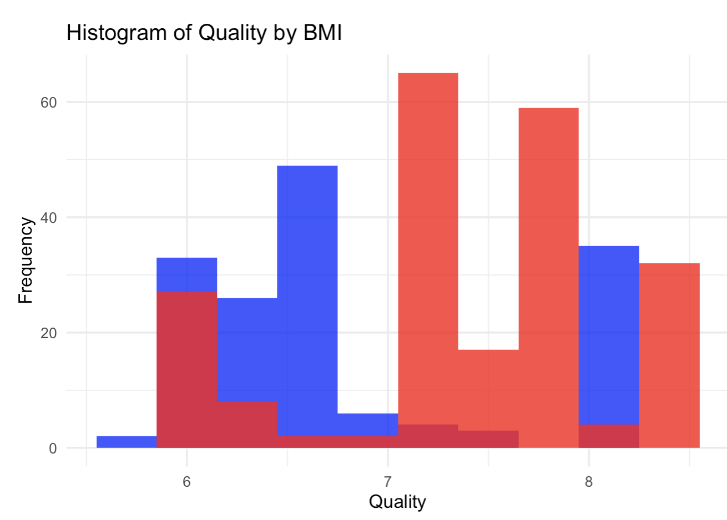
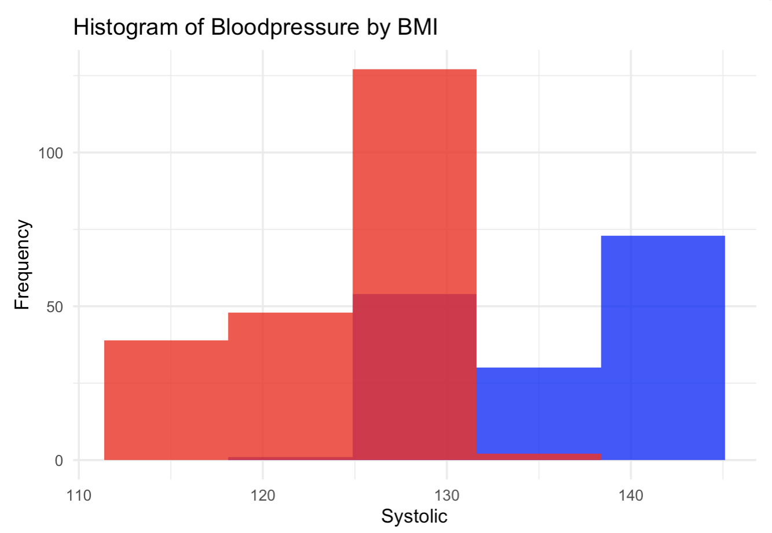
Histograms for Numerical Values by BMI
0= Overweight
1= Normal

Slide 12
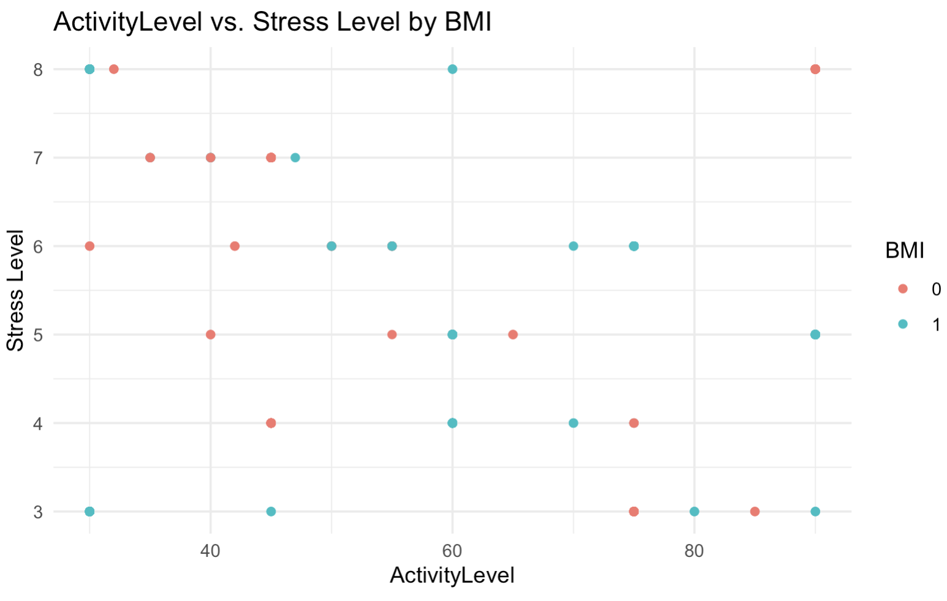
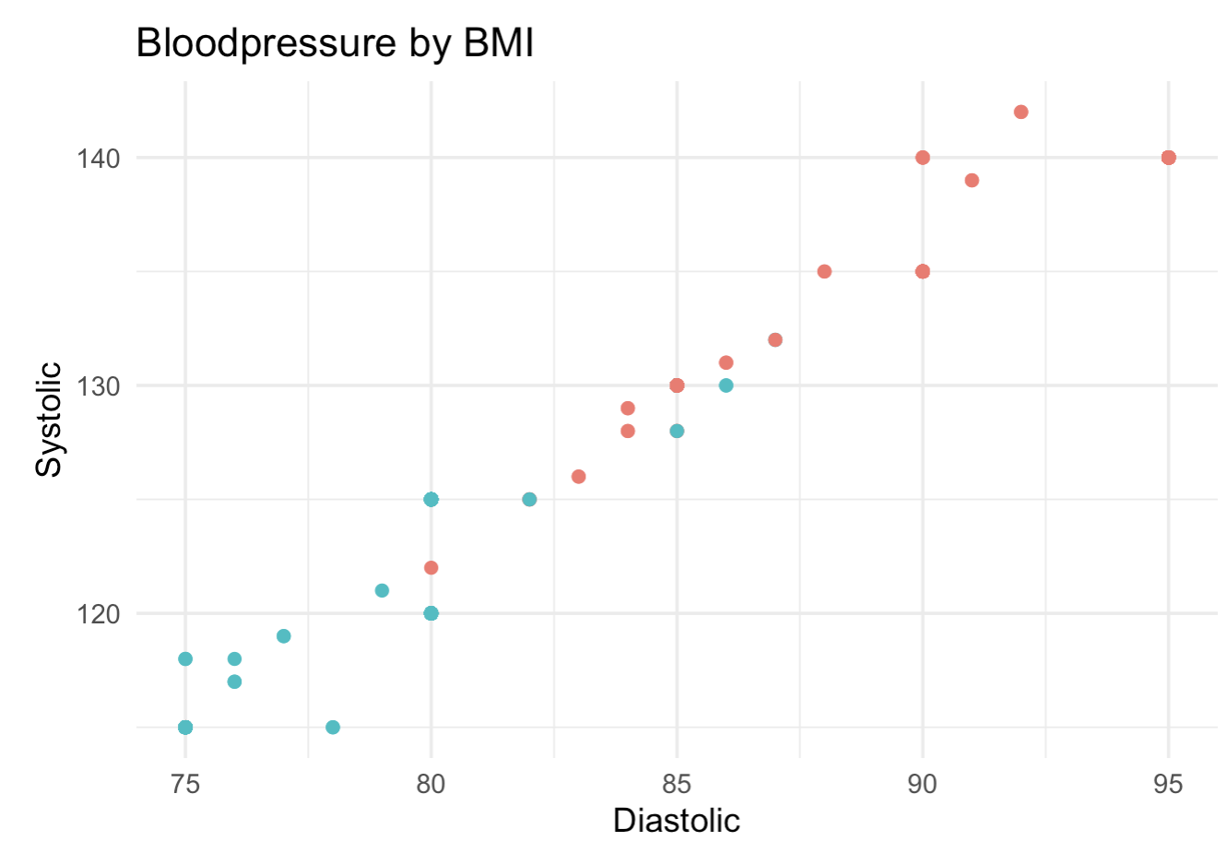
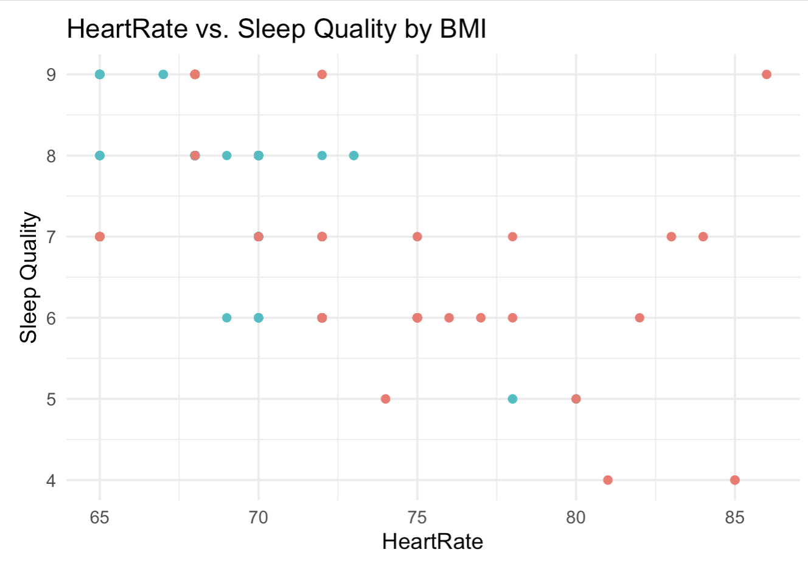
Scatterplots for Numerical Values by BMI
0= Overweight
1= Normal
More ActivityLevel, reduce Stress Level and possible
overweight
People with overweight tend to have higher HR
Higher HeartRate reduces Sleep Quality
As Blood Pressure increases overweight also
increases

Slide 13
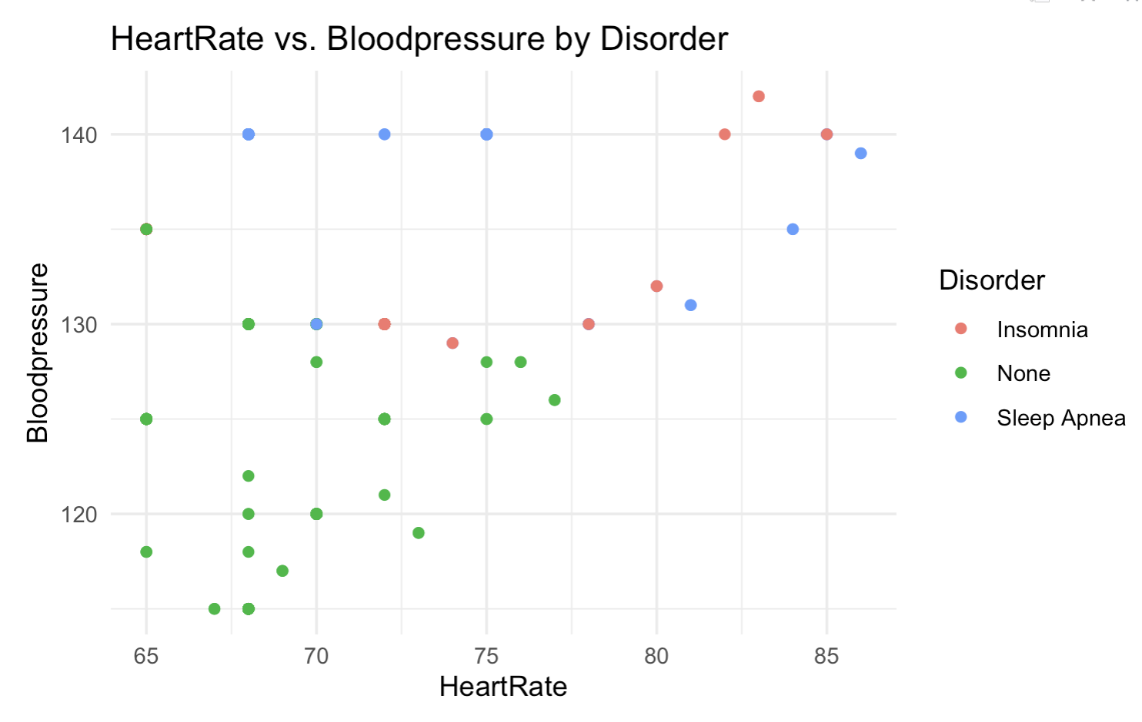
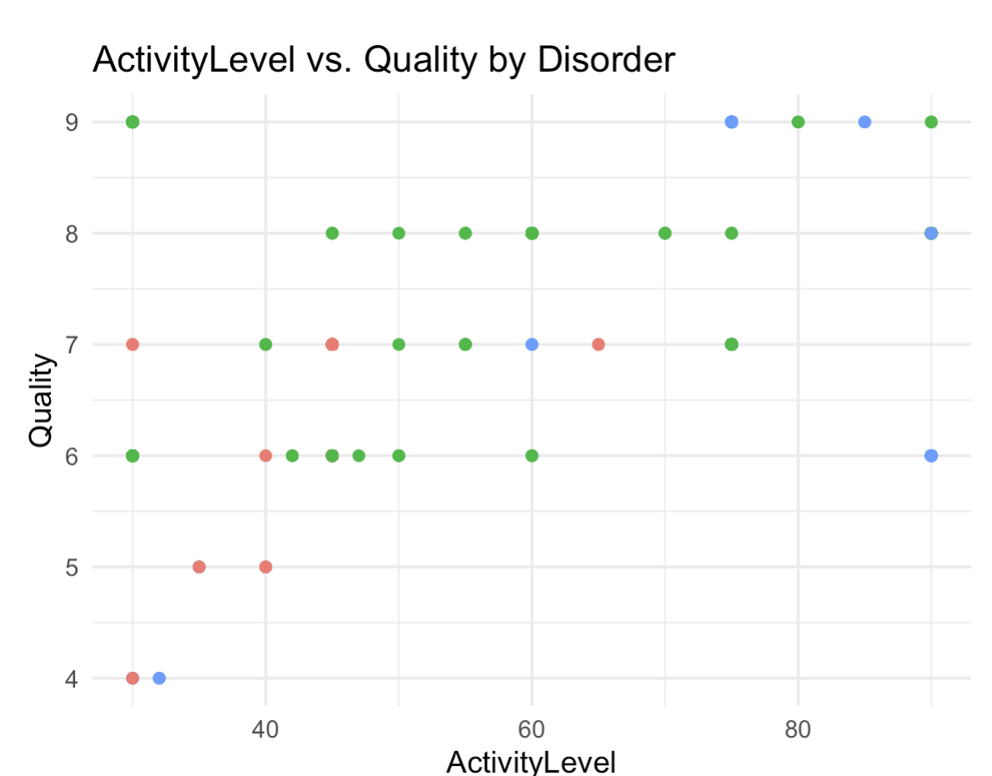
Scatterplots for Numerical Values by Disorder
High BP and HR are correlated
and produce Sleep Disorders
Higher ActivityLevel improves Quality and
has less Sleep Disorders

Slide 14
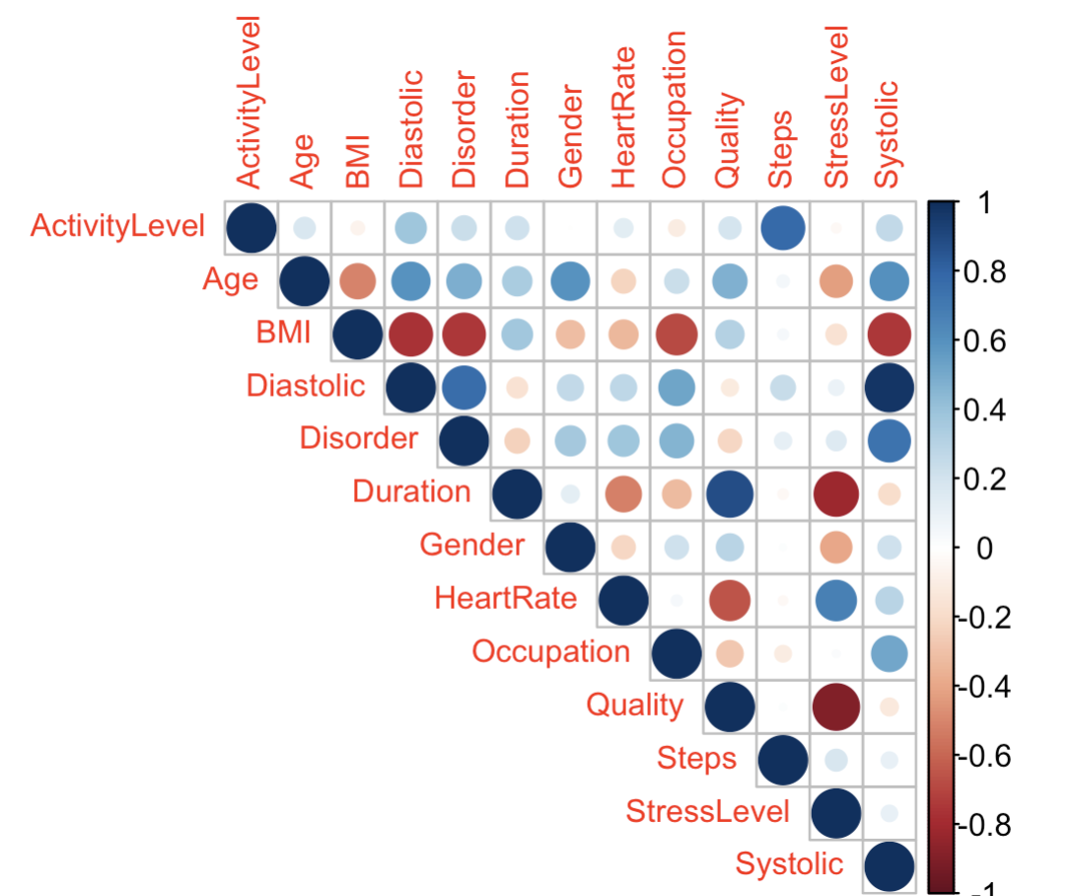
Correlation Matrix
Highest positive Correlations:
Duration & Quality (0.88)
DIstolyc/Systolic & Disorder (0.70)
HeartRate & StresLevel (0.67)
Highest negative Correlations:
Quality & StressLevel (-0.89)
Duration & StressLevel (-0.811)
Disorder & BMI (-0.81)
BMI and DIstolyc/Systolic (-0.769)

Slide 15
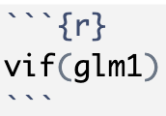
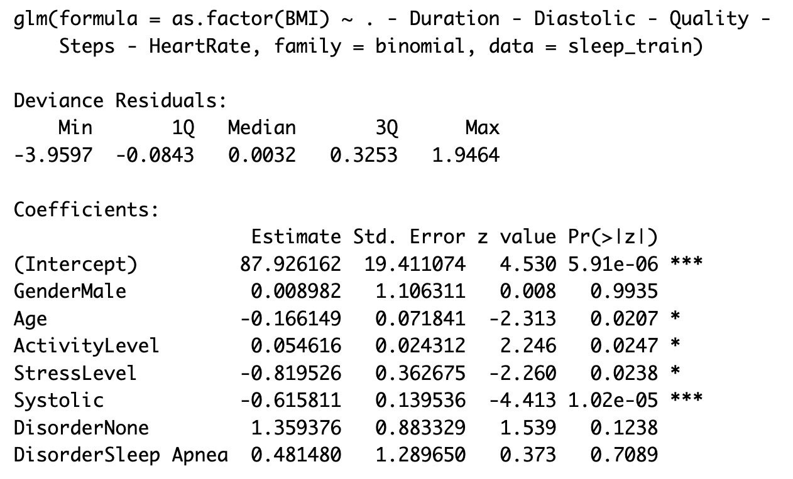
Modelling: Logistic Regression
Predict weather someone will have overweight (0) or not(1)
Dispersion for binomial family is taken to be 1 (normal weight)
Small Coefficients
Age, AL, SL and BP significant
Less BP -> Normal Weight (-0.68)
Less stress -> Normal Weight (-0.82)
More activity-> Normal Weight

Slide 16
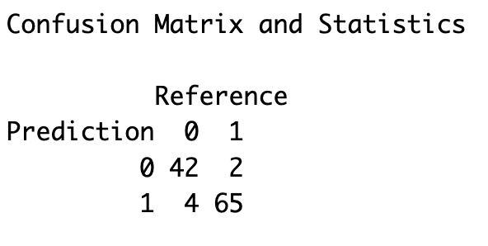
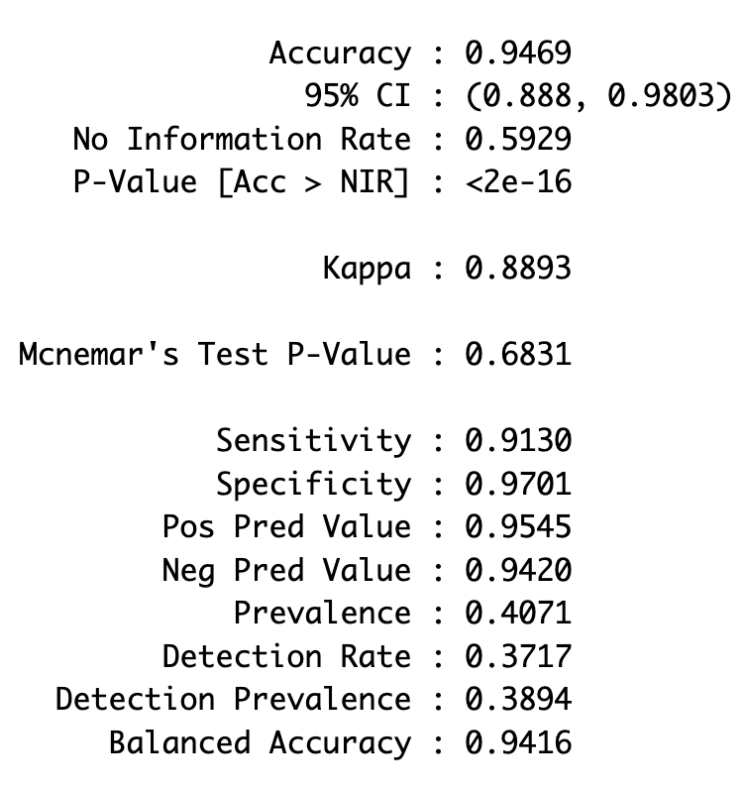
Modelling: Logistic Regression
Predict on Testing Set
Accuracy: 94.69%
Sensitivity: 91.30%
Specificity: 97.01%
Identifies better normal weight

Slide 17
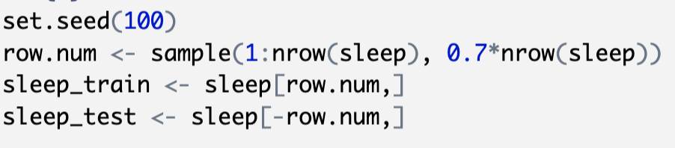
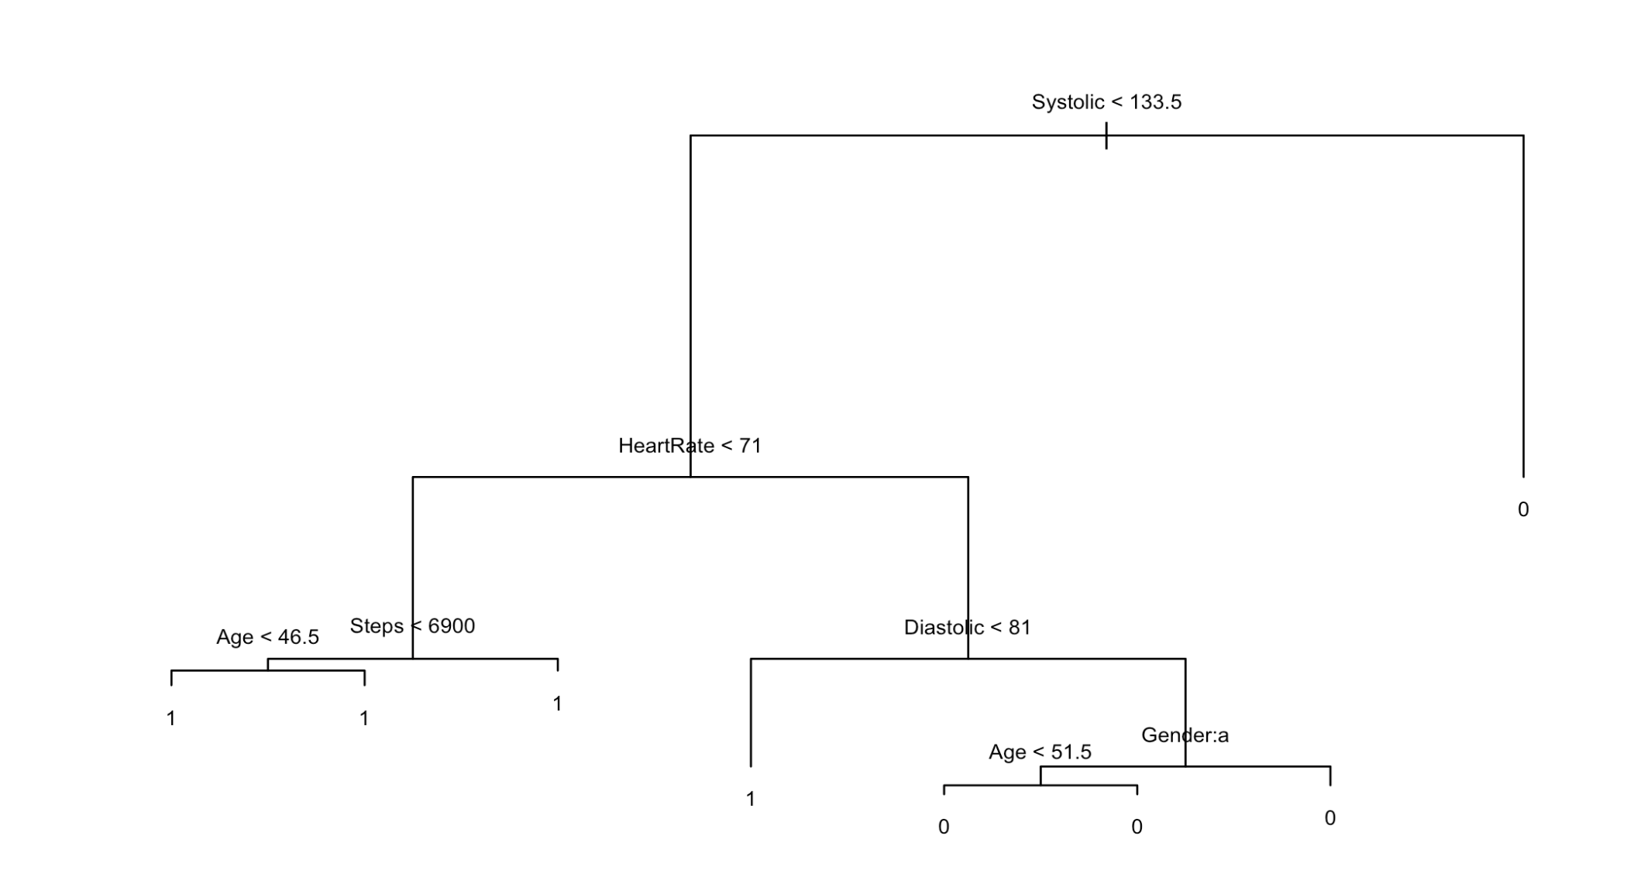
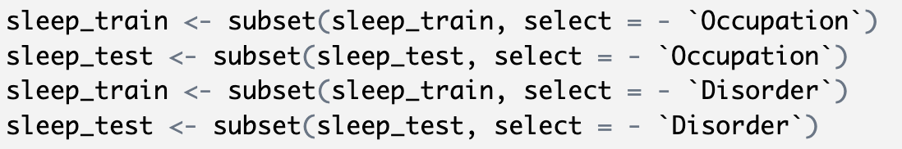
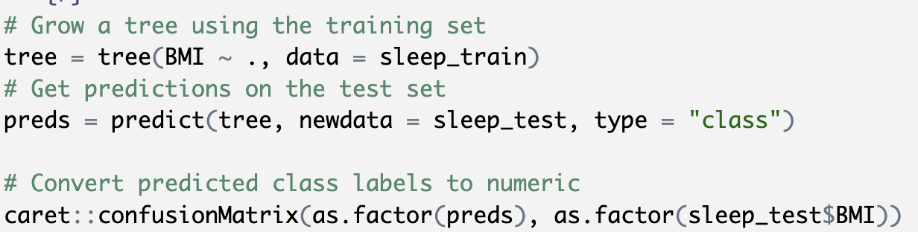
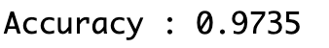
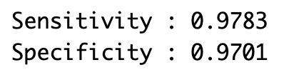
Modelling: Decision Tree
Unpruned Decision Tree

Slide 18
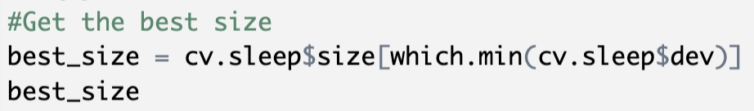
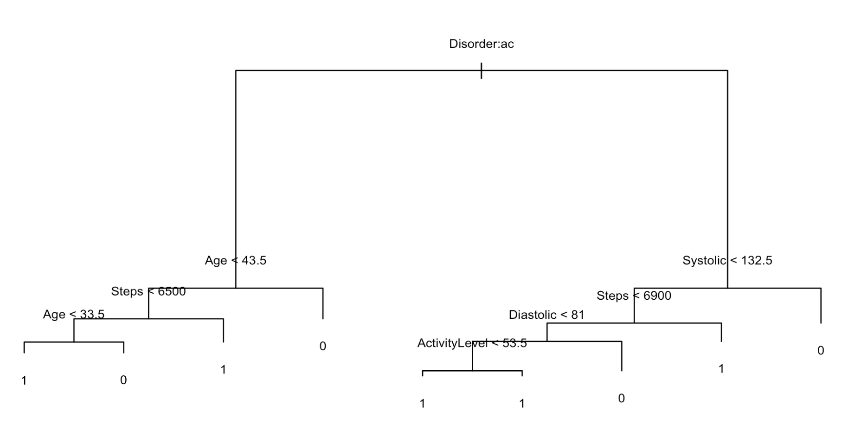
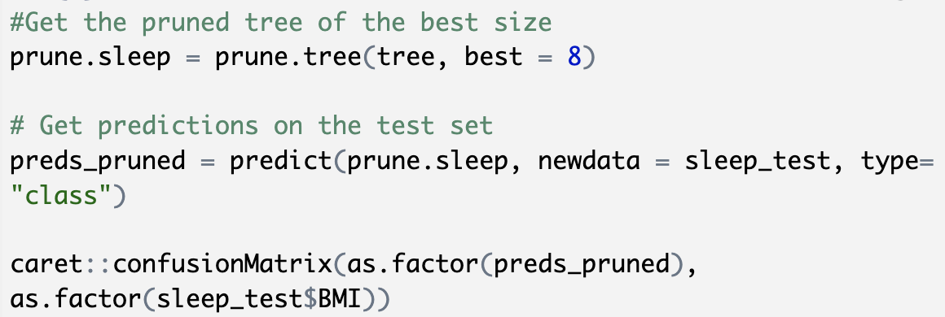
Modelling: Decision Tree
Pruned Decision Tree

Slide 19
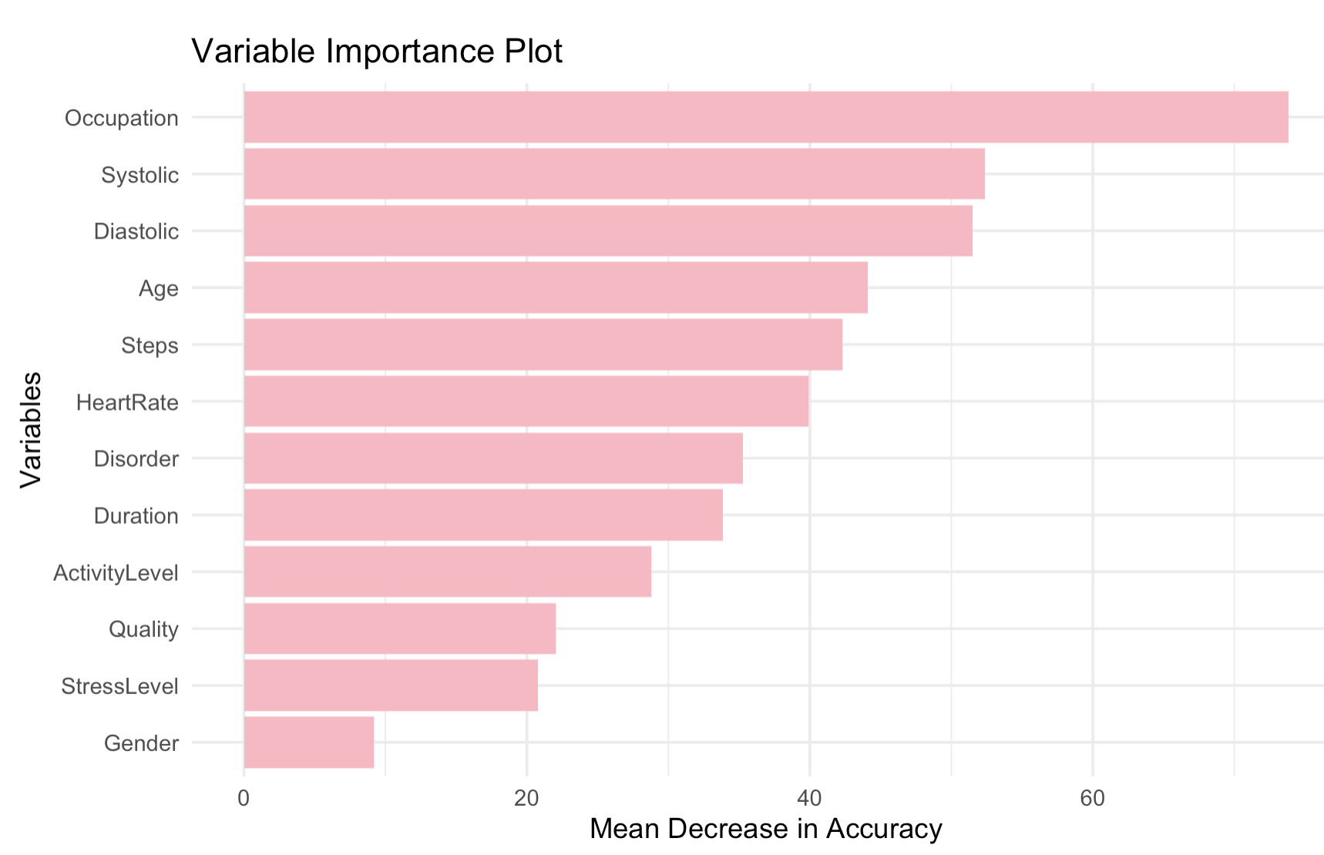
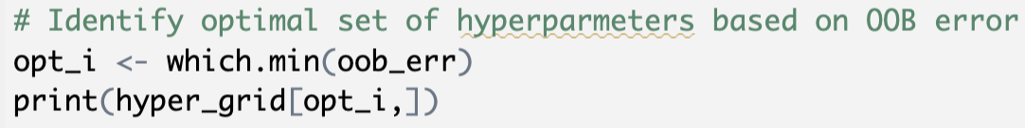
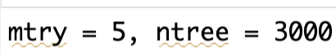
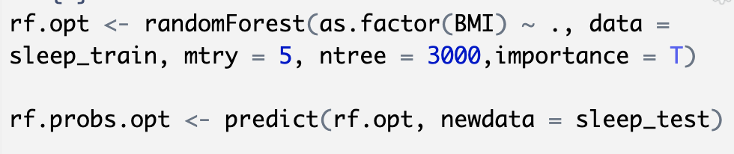
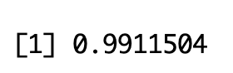
Modelling: Random Forest
Identified Optimal Set of Hyperparameters
Built Random Forest with tuned parameters
Predicted on testing set
Accuracy: 99.1%

Slide 20
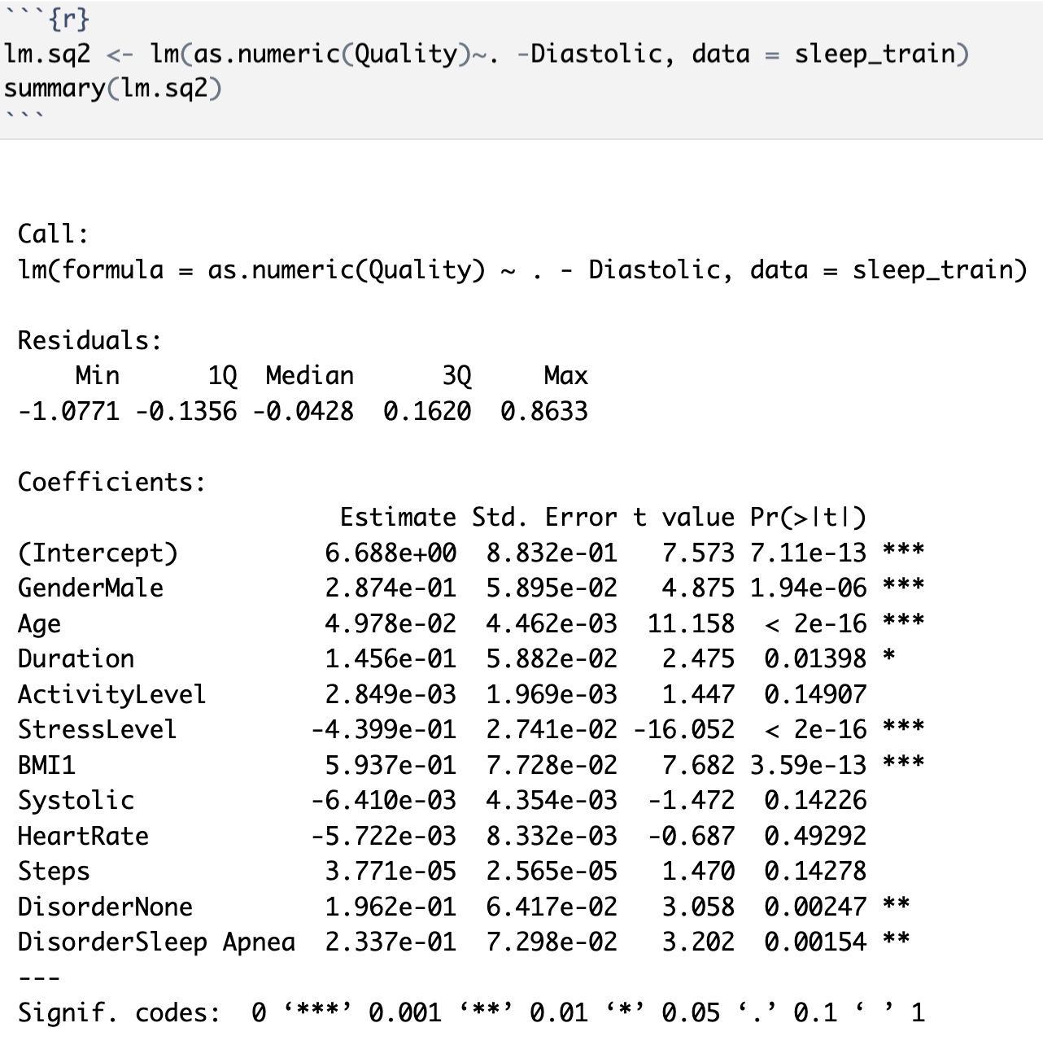
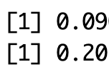
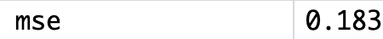
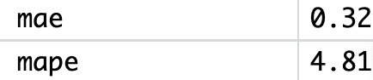
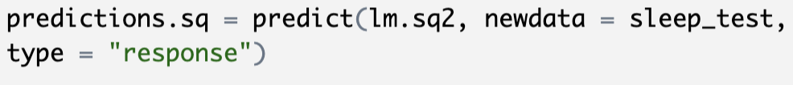
Modelling: Linear Regression (Quality)
R^2: 95.05%
Coefficients indicate that the following variables help for better sleep:
Males (2.87)
Older people (4.97)
Lower Stress Levels (-4.34)
Lower Heart Rate (5.7)
No Disorders (1.92)
Normal Weight (5.94)
Variable may not have a
substantial effect on the dependent
variable

Slide 21
Model Summary
Model | Test Accuracy | Sensitivity | Specificity
Logistic Regression | 0.9469 | 0.9130 | 0.9701
Decision Tree | 0.9735 | 0.9783 | 0.9701
Random Forest | 0.9912 | 0.9783 | 1.000
Model | R^2 | MSE | Mae
Linear Regression | 0.9510 | 0.090 | 0.205

Slide 22
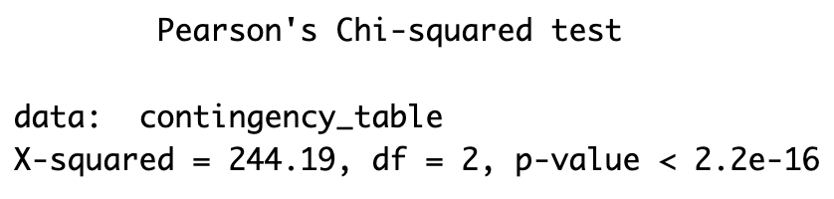
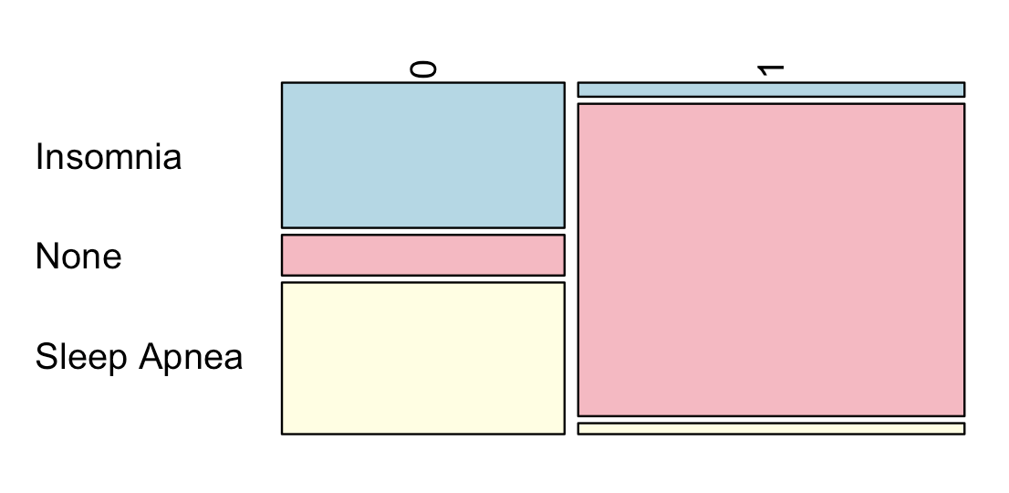
Statistical Inference Testing
Chi-Square Test for Sleep Disorder & BMI
Null hypothesis (H0): There is no significant association between BMI and Sleep Disorder
Alternative hypothesis (H1): There is significant association between BMI and Sleep Disorder
We reject H0
Since the p-value is lower than 0.05
There is significant association between
BMI and Sleep Disorder

Slide 23



Statistical Inference Testing
T-Test Quality/Heart rate & Activity level
Null hypothesis (H0): There is no significant difference in the mean test scores between ActivityLevels and Sleep Quality.
Alternative hypothesis (H1): There is significant difference in the mean test scores between ActivityLevels and Sleep Quality.
We reject H0
There is a statistically significant difference
between the mean Sleep Quality
and mean ActivityLevels & HR + AL
This result suggests that there is an association between the variables (individuals with higher activity levels indeed have better sleep quality).

Slide 24
Findings & Results
Model | Test Accuracy | Sensitivity | Specificity | Best Predictors
Logistic Regression | 0.9469 | 0.9130 | 0.9701 | BP, Age, Stress(-) AL(+)
Decision Tree | 0.9735 | 0.9783 | 0.9701 | Disorder, Age, BP, Steps, AL
Random Forest | 0.9912 | 0.9783 | 1.000 | Occupation, BP, Age, Steps, HR
Model | R^2 | MSE | Mae | Best Predictors
Linear Regression | 0.7608 | 4.418 | 1.498 | Stress, AL, Steps,Disorder

Slide 25
Findings & Results
Which variables are significant predictors of BMI and could reduce obesity?
From the models , we can conclude that Random forest had the best
Accuracy overall, when predicting BMI.
From models we found the following out:
As BloodPressure, Age and Stress decreases, Weight descreases.
As ActivityLevel and Steps Increase, Weight decreases.
BP, Age, Stress, Disorder, Occupation and HR are best predictors of BMI.
67% of Females and 33% of Males have overweight.
Some Occupations have more people with overweight, we found out that
Gender played a significant role in that.
Do obese people have sleep disorders & bad sleep quality, how can it be improved?
88% of people with obesity have sleep disorders
From visualizations, Correlations & Chi-Square:
Overweight = Bad Sleep Quality & Disorders
Higher HR, BP & SL= Bad Sleep Quality & Disorders
More AL & Steps = Better Sleep Quality
From Linear Regression:
Age, Duration, Normal Weight = Better Sleep Quality
High StressLevel reduces Sleep Quality

Slide 26
Findings & Results
Which variables influence high BP or HR?
From the Visualizations, high HeartRrate & BloodPressure are influenced
by Overweight
More Steps and ActivityLevel reduce both HR, BP and Stress
From Correlations, HeartRate is influenced by StressLevel
From T-Test StressLevel and Heartrate & StressLevel and Blood pressure correlate with each other
Which other variables correlate with each other?
We observe that Age significantly influence overall health status
Quality & Duration are correlated
Stress level and HeartRate influenced each other
Activity level & Steps are correlated

Slide 27

Recommendations for a better Health
We can conclude that BMI adversely affects health by elevating blood pressure and heart rate, as well as contributing to diminished sleep quality and the onset of sleep disorders.
We saw that stress and BMI were correlated, but our analysis did not allow us to determine the direction of causality.
High stress levels corresponded with elevated heart rates.
All this can lead to diseases, diabetes, sleeping disorders and poor health.

Slide 28
Recommendations for a better Health
We have the following recommendations to improve health:
More Steps
More Activity
Both variables reduced BMI and stress, which consecutively reduces heart rate, blood pressure and improves sleep quality and sleep duration, causing less sleep disorders.
Trying to reduce Stress by meditating (for example) would help reduce heart rate, causing less heart diseases.
We would like to expand our dataset to include additional variables such as dietary habits, smoking status, or pregnancy, to further investigate this and develop better methodologies aimed at enhancing health outcomes.
Additional observation (1000+) would also help get more accurate results.

